Slide 1
Understanding Object Interactions via Our ATM OO Design and Implementation Case Study
Paul Deitel, CEO
Deitel & Associates, Inc.

Slide 2
Contact Information
Paul Deitel, CEO
Deitel & Associates, Inc.
Twitter: @deitel/@pdeitel
Facebook: http://tinyurl.com/deitelfacebook
deitel@deitel.com
www.deitel.com
Source Code: http://tinyurl.com/ATMCaseStudy

Slide 3
Our Early OO Days
1991
Our first C++ corporate seminar
Lots of Live-Code examples
  Complete working programs
  Prove that features work

Slide 4
Our Early OO Days
OO presentation
  Create one or more classes
  Create one or more objects of those classes
  Call the objects’ methods to do stuff

Slide 5
Missing Piece of the Puzzle
How do objects interact with one another?

Slide 6
ATM Case Study
Popular example—people can relate to it
Available in 4 languages
  Java, C++, Visual Basic and Visual C#
    “How to Program” books
Fully solved
  Encourages instructors to work it into first or second programming courses that cover OO
  Encourages students to study on their own if it’s not part of a course

Slide 7
Corporate Trainers
Case study often helps us close a deal
  Especially for non-OO audiences
Students comment on evals that it ties the OO concepts together in a meaningful way
3 to 4 hours to present in detail

Slide 8
Simplifying Assumptions
Bank has one ATM
Emulate what an ATM does
One account per user
Username and PIN entered by user at keyboard—no card reader
Use software to simulate certain hardware
Use an object to represent the database
Separate system validates deposits
…

Slide 9
Case Study Coverage
Starts with System Requirements
Presents 6 UML diagram types
  Use case, class, state machine, activity, communication, sequence
  Others overviewed in an appendix
Simplified design process
  Requirements document
  Relate this to the final code we generated from it

Slide 10
Diagrams
Use case diagrams
  Interactions between a system and its external entities (actors)
  View Account Balance, Withdraw Cash and Deposit Funds
Class diagrams
  Model classes used in a system.
  Specify structural relationships between system parts
State machine diagrams
  Model how an object changes state
  Indicated by the values of object attributes at a given time

Slide 11
Diagrams
Activity diagrams
  Model workflow during program execution
  Model actions and order in which they’re performed
Communication diagrams
  Model interactions among objects
  Emphasis on what interactions occur.
Sequence diagrams
  Model interactions among objects
  Emphasis on when interactions occur

Slide 12
Parts of Our Design Process
Chapter 12
  Examine the Requirements Document
  Identify the Classes
  Identify Class Attributes
  Identify Objects’ States and Activities
  Identify Class Operations
  Indicate Collaboration Among Objects

Slide 13
Parts of Our Design Process
Chapter 13
  Start to Program the Classes
  Incorporate Inheritance and Polymorphism into the design

Slide 14
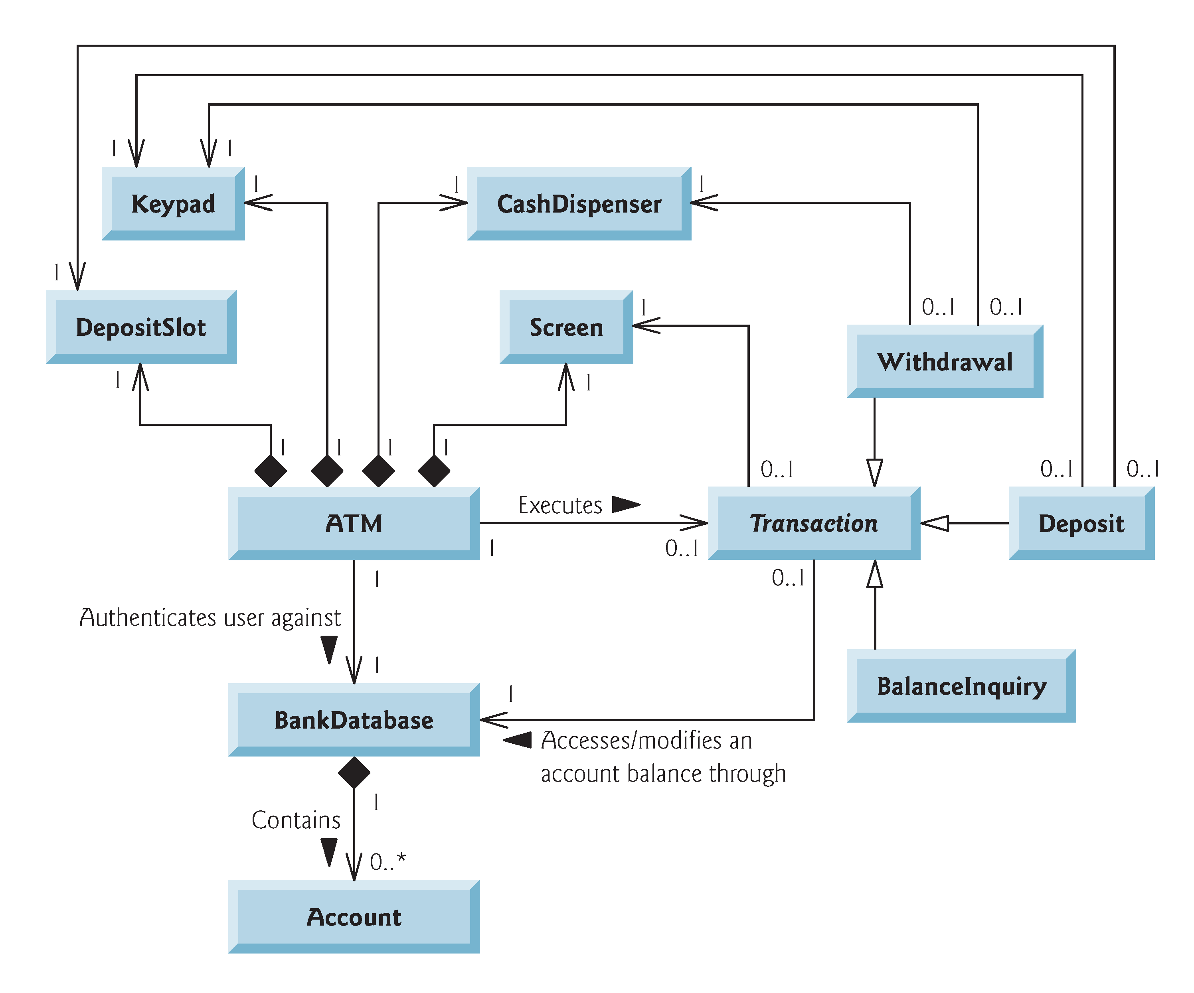
Final Class Diagrams

Slide 15
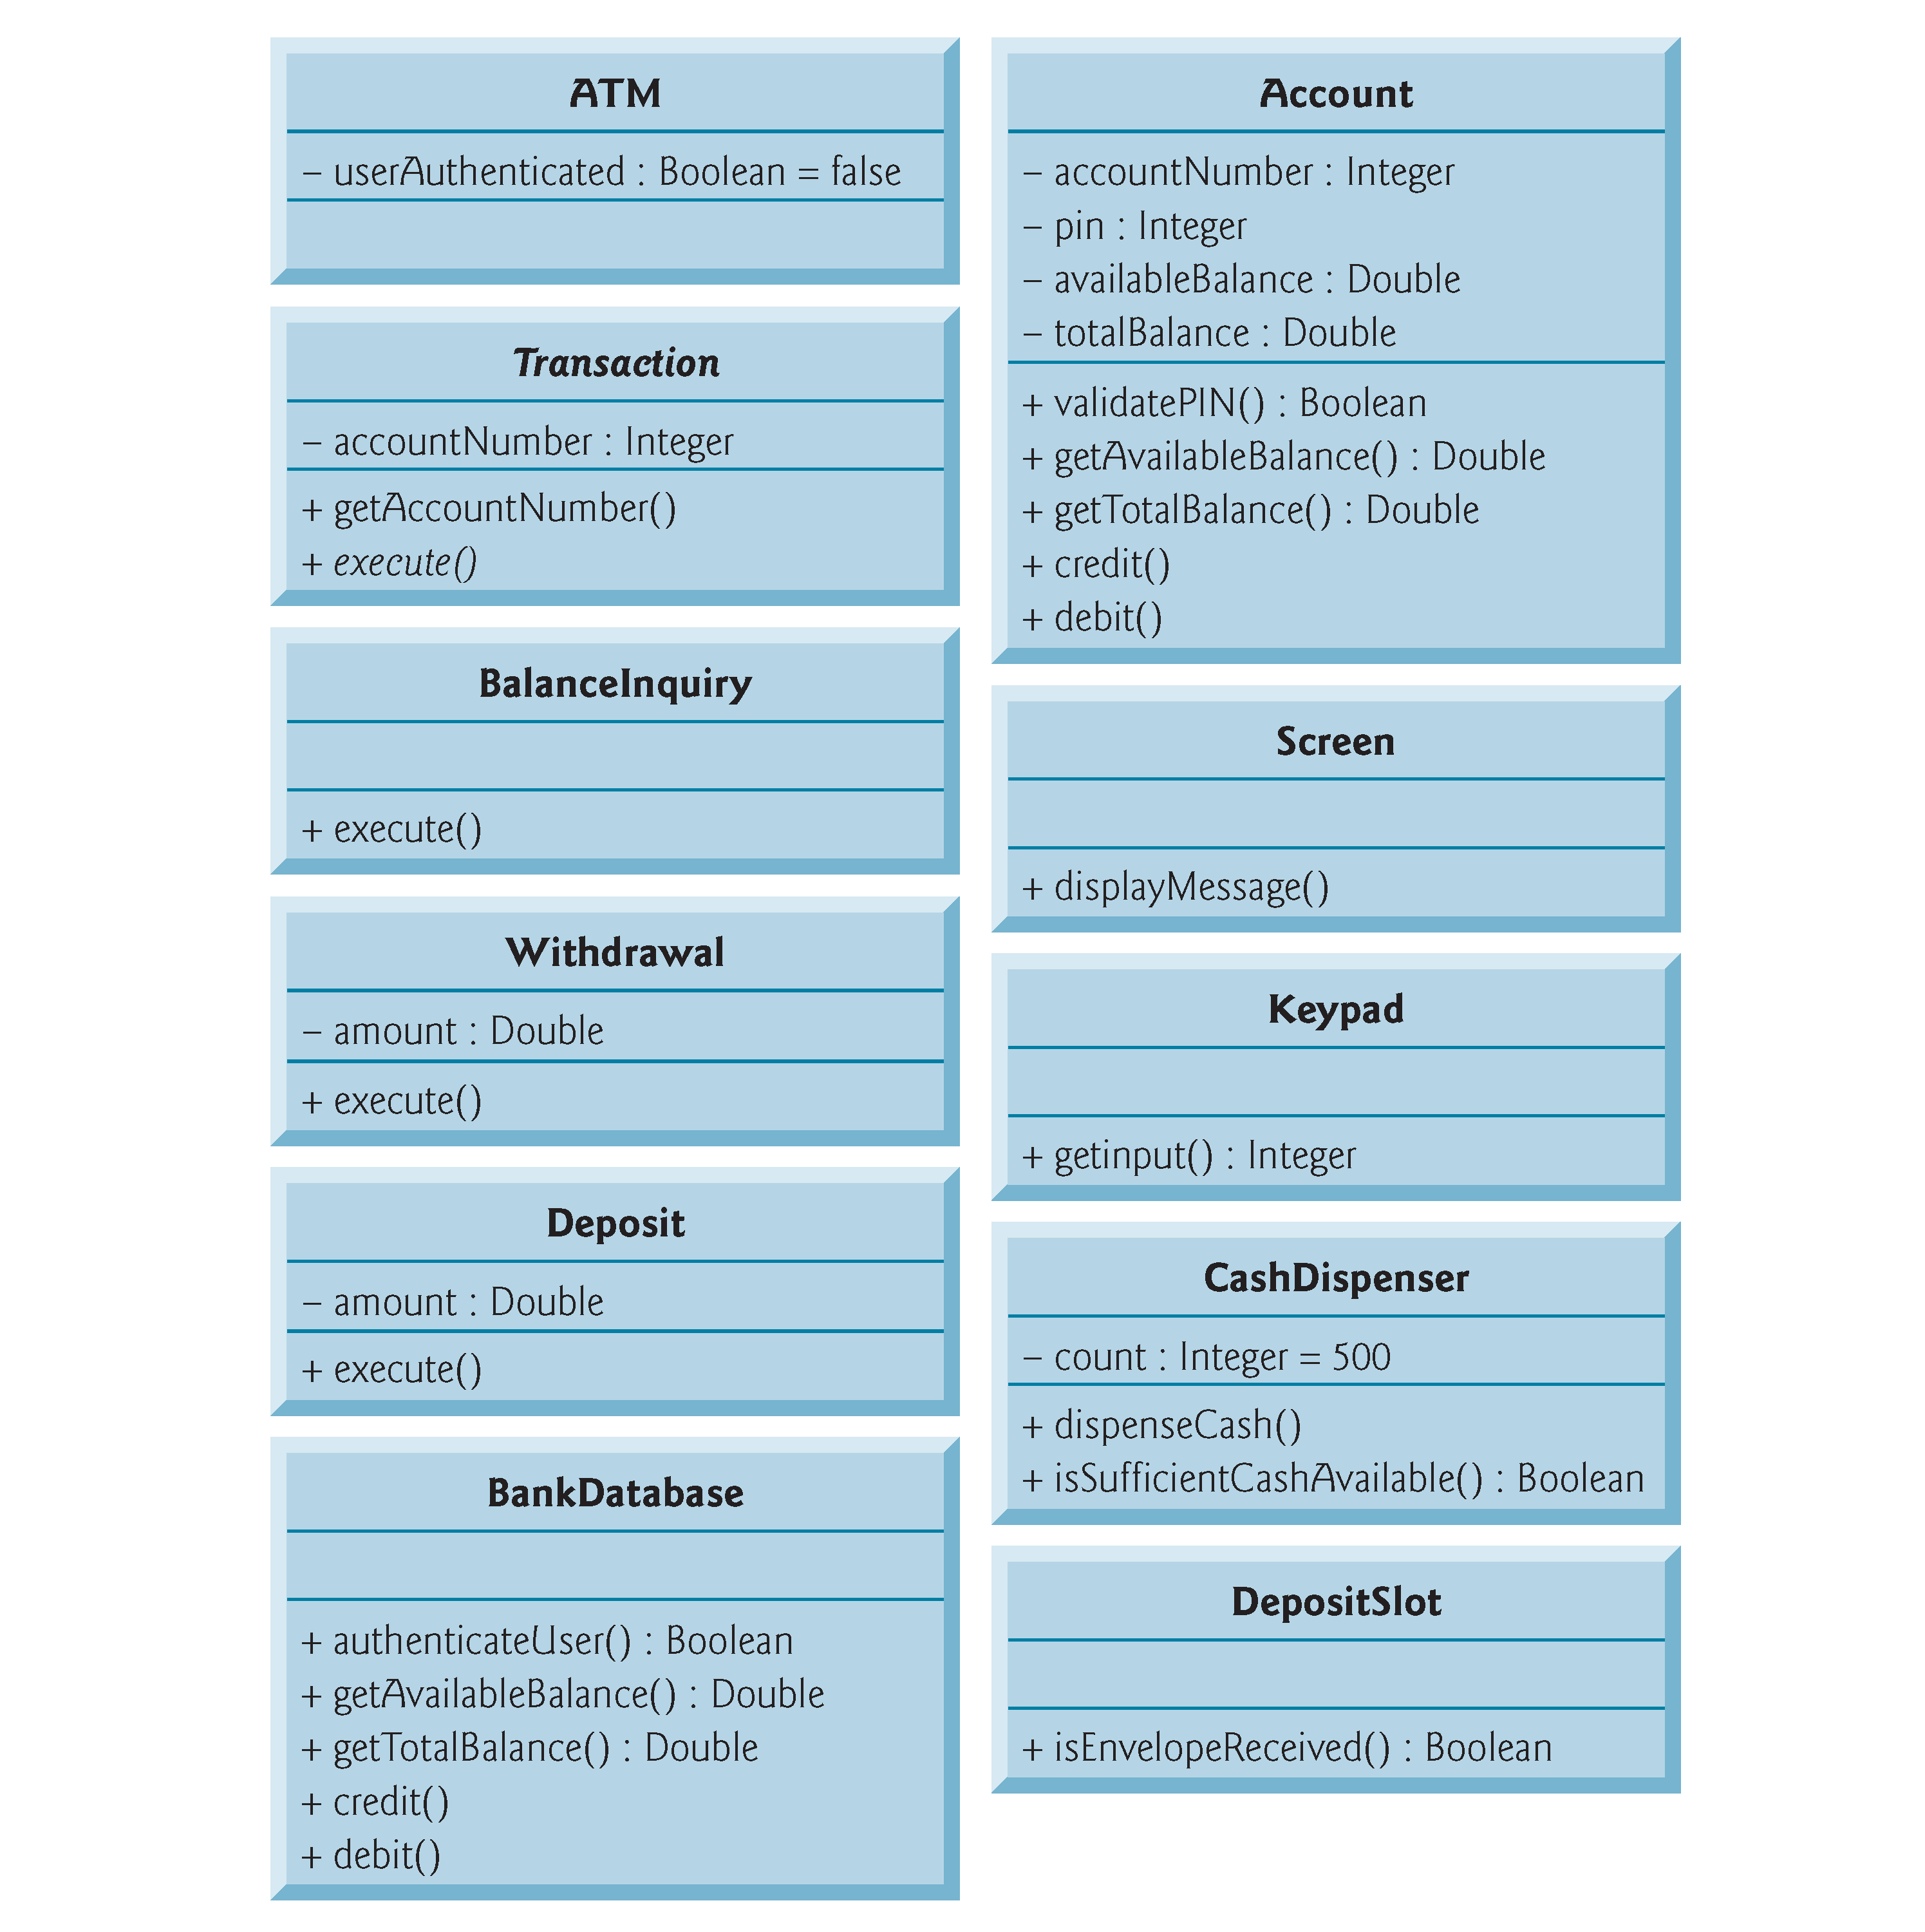
Final Class Diagrams

Slide 16
The Implementation
Implement the ATM System
  Discussion focuses on how we used the design to
    Determine each class’s name, attributes, behaviors and relationships to other classes
    Determine the objects to create
    Implement interactions between objects as member-function calls
  Also how we determined additional attributes, behaviors and interactions that were not in the original design

Slide 17
How I Present It
Read the Requirements Document
Explain the simplifying assumptions
Discuss the simplified design process
Discuss each UML diagram
  Purpose
  How it helps you write the code that implements the system

Slide 18
Contact Information
Paul Deitel, CEO
Deitel & Associates, Inc.
Twitter: @deitel/@pdeitel
Facebook: http://tinyurl.com/deitelfacebook
deitel@deitel.com
www.deitel.com
Source Code: http://tinyurl.com/ATMCaseStudy

